Slide 1


Popular Streaming Analysis

Slide 2


Today's agenda
Project recap
Problem
The Analytics team
Process
Insights
Summary

Slide 3


Project Recap
Tasks:
An Audit to Soial Buzz’s Big Data practice
Recommend for succesfull IPO
Find top 5 most popular Categories of cntent.

Slide 4


Problem
What are the social Buzz’s Top 5 most Popular Categories ?

Slide 5



Andrew Flaming
Chief Technical Architect
The Analytics team
Marcus Rompton
Senior Principal
Minaam Muzaffar
Data Analyst

Slide 6

Process
1
Data UnderStanding
2
Data Cleaning
3
Data Modeling
4
Data Analysis
5
Uncover Insights

Slide 7


Insights
16
16
4
Tottal Categories
Types of Reactions
Content Types

Slide 8
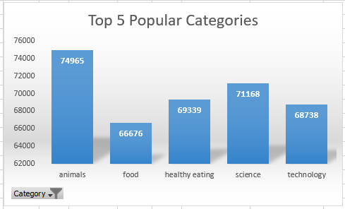
The top 5 most popular content categories on social media are:
Animals: Consistently high engagement, with cute, funny, or interesting animal content resonating with many users.
Food: Broad category encompassing recipes, reviews, trends, and general food enjoyment.
Healthy Eating: Gaining traction as people focus on wellness, with recipes, tips, and challenges finding an audience.
Science: Fascinating discoveries, experiments, and explanations can spark curiosity and capture viewers' imaginations.
Technology: New gadgets, reviews, and social media's ever-evolving nature keep users interested in tech content.

Slide 9
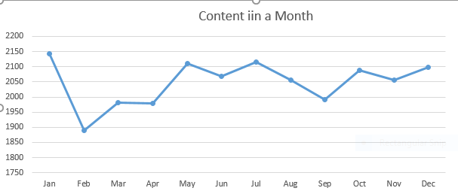
Interestingly, January seems to be the month with the highest content upload volume, with a staggering 2,142 pieces uploaded in that period.

Slide 10


Content Categories:
Social Buzz offers 16 content categories, with animals, food, healthy eating, technology, and science emerging as the most popular.
Reactions:
Users can express their opinions on content through 16 different reaction types. Each reaction type has a score assigned to it, reflecting its weight or significance.
Top Performers:
Among the 16 categories, animals reign supreme, garnering the most reactions (1,897) on Social Buzz.
Seasonal Trends:
Interestingly, January sees the highest volume of content uploads on Social Buzz, with a whopping 2,142 pieces uploaded in that month. Further investigation is needed to understand the reasons behind this peak (e.g., New Year's resolutions, seasonal trends).
Summary

Slide 11

Thank you!
ANY QUESTIONS?

